Slide 1


Predicting Hospital Admission With A Patient-Centered Framework
Denis Ouellette
Katy Mombourquette

Slide 2
Introduction
A universal experience: visiting hospital emergency.
Getting there, maybe with great haste, just to wait (usually).. Why?
Triage Procedure based on:
Severity
Available Resources
Severity
Is your emergency life-threatening? You may not know!
How urgent is your condition if not life-threatening?
Available Resources
Staff on-shift
Medical instruments and tests
Technology
What are the limitations of the resources we use? How can we improve?
Background Research & Data Source¹
__________________________________________________________________________________________________
¹ Hong WS, Haimovich AD, Taylor RA (2018) Predicting hospital admission at emergency department triage using machine learning. PLoS ONE 13(7): e0201016 https://doi.org/10.1371/journal.pone.0201016.

Slide 3
Business Understanding
Client
Scenario
Deliverables/Goals
The Yale New Haven
Health System (YNHHS)
Who they are: A non-profit health system
What they include: Hospitals, a medical foundation, several multispecialty centres, and outpatient locations
What areas they cover: Westchester, New York to Westerly, Rhode Island
Product:
“Integrated, high value, patient-centred care”
Due to pressure to increase support for individuals facing a language barrier (i.e. minority demographics) on university campuses, YNHHS hired us to look at their existing triage data and improve triage for patients of that specific case.
What are the overarching trends among emergency department patients?
Are discrepancies between treatment and utilization of healthcare present between different first language speakers?
Cleaned and preprocessed historical triage data from YNHHS hospitals.
A machine learning model with an accuracy of 85% or higher
False Negatives (i.e. patients who were falsely discharged) no more than 5%.
False Positives (i.e. patients who were falsely admitted) no more than 25-35%
Data visualizations and interactive dashboards presenting patient predictions, trends and figures that support the client’s needs.

Slide 4
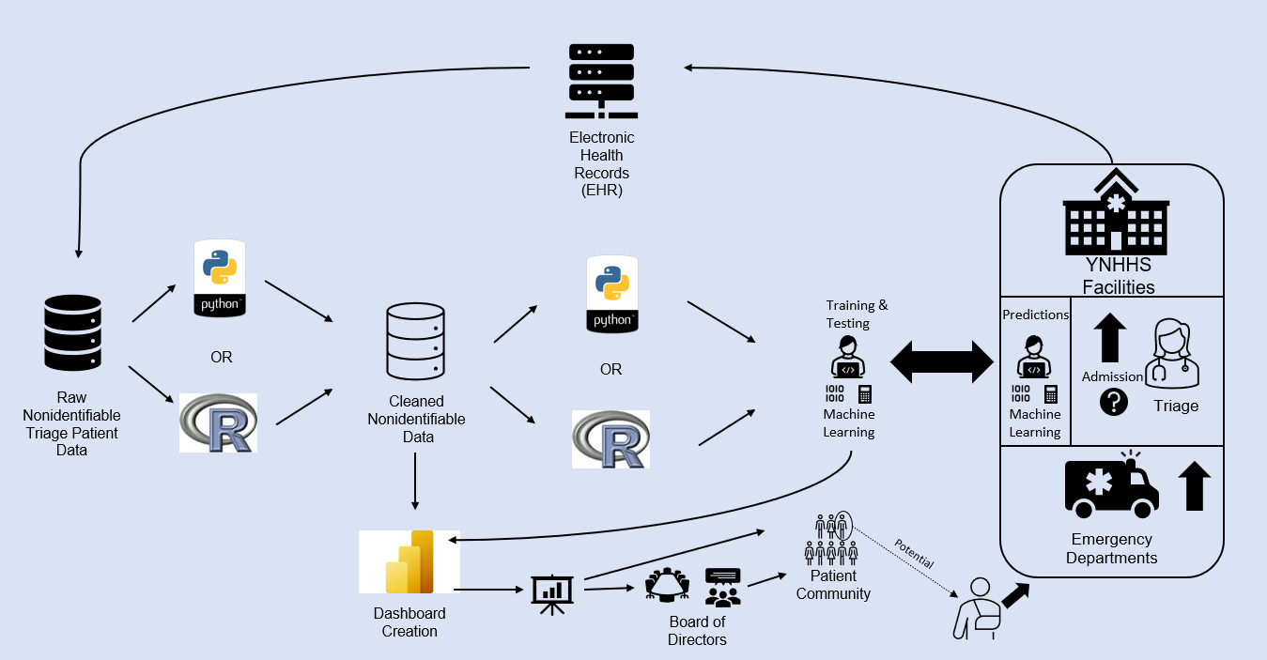

Slide 5
Data Dictionary
Excerpt of Data Dictionary
Variable Category | Variable Example | Description | Data Type
Response Variable | disposition | Admission (1) vs. Discharge (0) | Binary
Demographics | employstatus | The patient's status of employment: full-time, part-time, student, unemployed, or retired | Categorical
Demographics | lang | The patient's primary language (English vs. Other) | Binary
Triage Variables | triage_vital_hr | Heart rate recorded at triage | Numeric
Triage Variables | esi | ESI level determined by triage nurse | Numeric
Hospital Usage | n_edvisits | Number of ED visits within the past year | Numeric
Hospital Usage | n_admissions | Number of in-patient admissions within the past year | Numeric
Chief Complaint | cc_abdominalcramping | Abdominal cramping | Binary
Chief Complaint | cc_motorvehiclecrash | Motor vehicle crash | Binary
Past Medical History | Anxietydisorders | Anxiety disorders | Binary
Past Medical History | Spincorinj | Spinal cord injury | Binary
Outpatient Medications | meds_antibiotics | Number of antibiotics | Numeric
Outpatient Medications | meds_vitamins | Number of vitamins | Numeric
Imaging | ekg_count | Number of EKG ordered in the ED within the past year | Numeric
Imaging | mri_count | Number of MRI ordered in the ED within the past year | Numeric
Historical Vitals | pulse_last | The last, min, max, and the median recorded value of all vitals taken in the ED within one year of the current visit | Numeric
Historical Labs | megnesium_median | The last, min, max, and the median recorded value of selected numeric labs ordered in the ED within one year of the current visit | Numeric
From "Predicting hospital admission at emergency department triage using machine learning" by Hong W.S., Haimovich A.D., and Taylor R.A.
Historical data from March 2014 – July 2017
Over 900 total columns grouped into categories
Based on similar table from original research paper
Source: Hong WS, Haimovich AD, Taylor RA (2018) Predicting hospital admission at emergency department triage using machine learning. PLoS ONE 13(7): e0201016 https://doi.org/10.1371/journal.pone.0201016.

Slide 6



Data Cleaning Process
Broke large dataset into small subsections
Assessed and filled any null values
Dropped unusable columns
Historical Labs and Vitals had over 300 columns combined with unique numbers of nulls and distributions
Nulls were filled according to each variable's distribution: normal – mean; skewed – median; binary – mode, etc.
based on the column categories outlined in original research paper

Slide 7
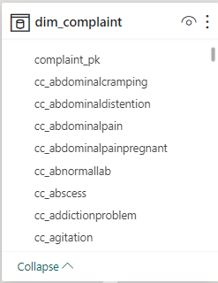
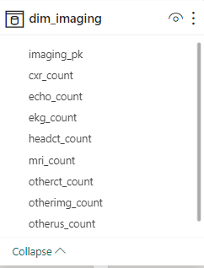
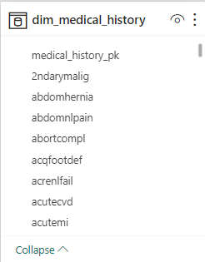
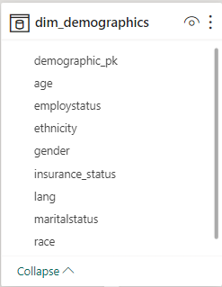
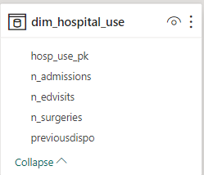
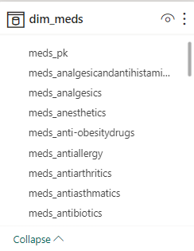
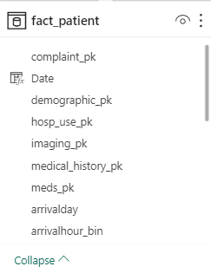
Data Modelling
Based on data dictionary categories
Fact patient includes information collected at triage + the other 6 dimension tables
Created using Python & PowerBI
Notes:
Based on data dictionary categories
Fact patient includes information collected at triage + the other 6 dimension tables
Created in PowerBI

Slide 8
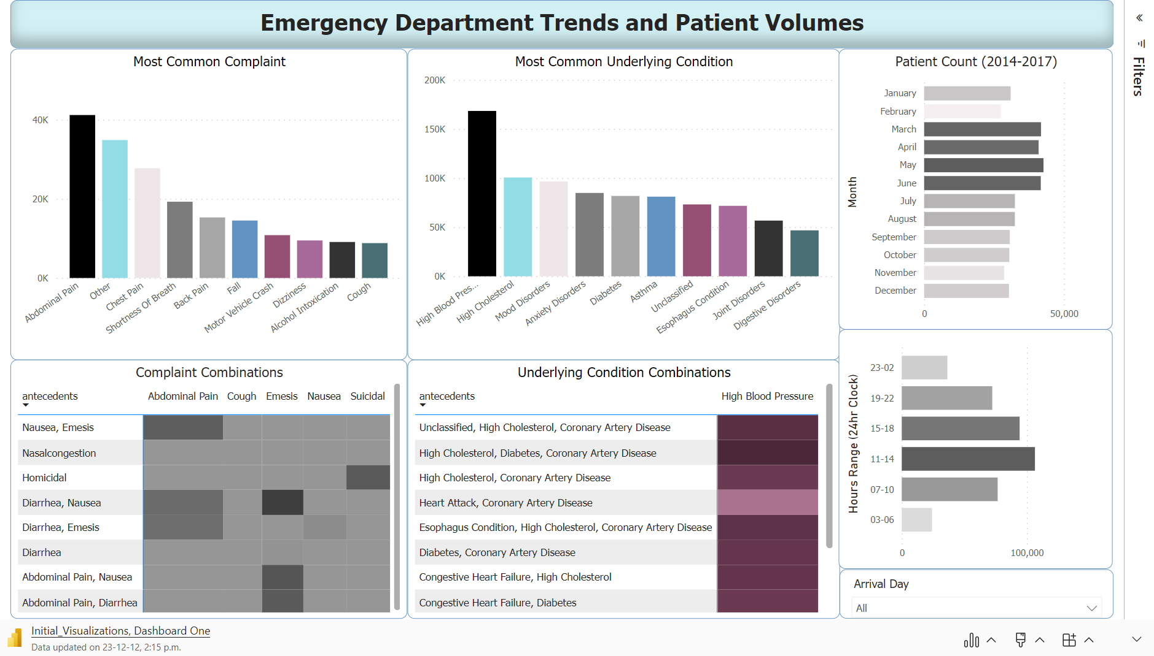

Slide 9
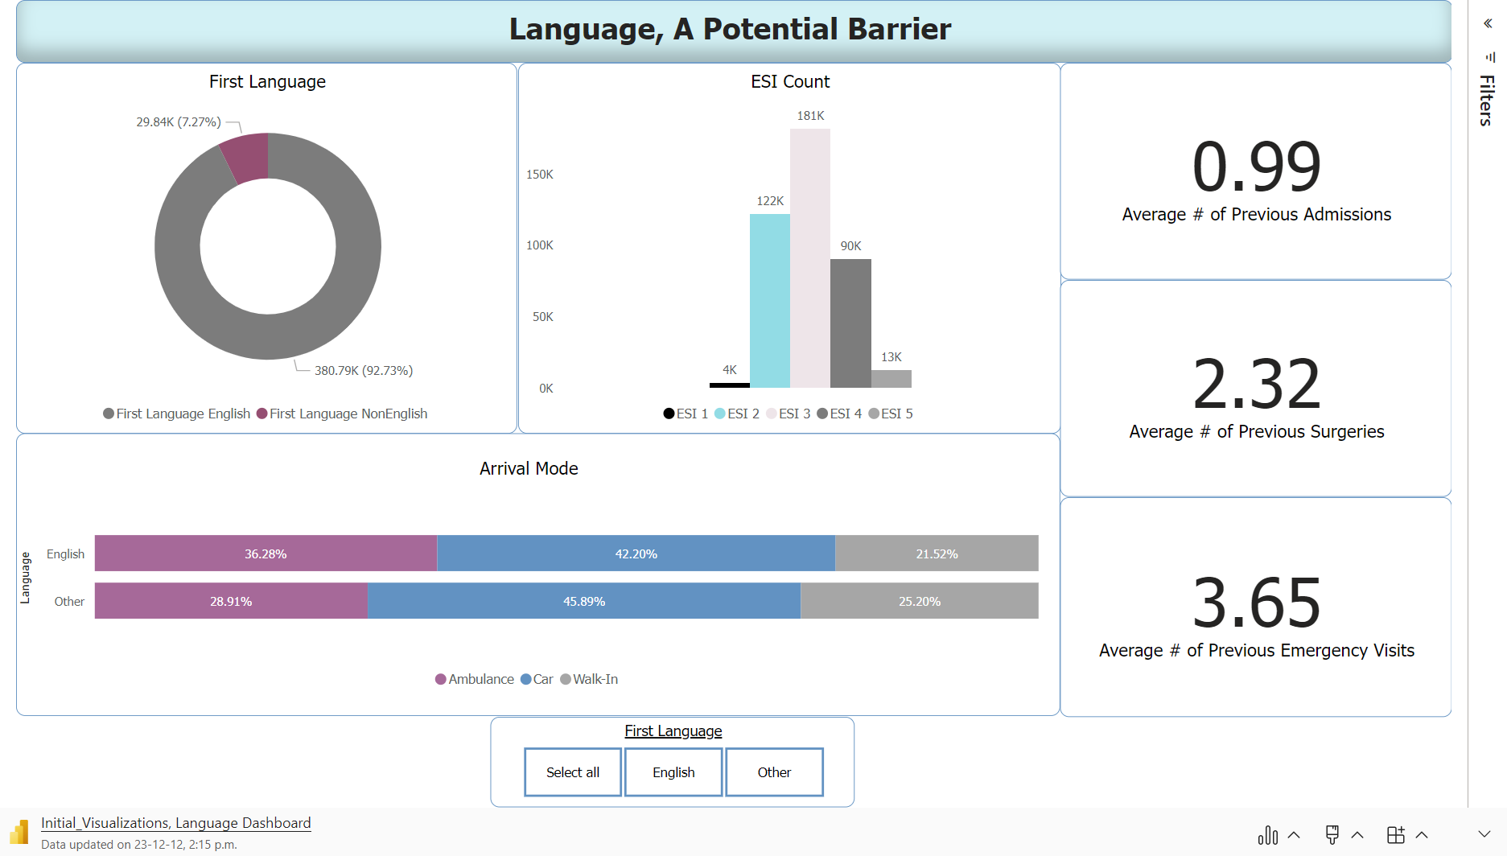

Slide 10



Data Prep for Model
Additional cleaning to keep variables unbiased and impactful
Encoding to numeric computer-readable data & defining sampling method
Creating preprocessing pipeline
Define the previous steps in the correct order for fitting of various models
Modelling data: Non-English-Speaking patients, and a Random Sample of Equal Size of English- Speaking patients.
Dropped irrelevant columns for our modelling. (e.g. race)
Oversampled the target variable to balance it and eliminate bias
Created column transformers with a one hot encoder, specialized transformers exist for each datatype
Splitting data into testing and training sets 80:20
Repeat testing processes
Define desired performance metrics
Defined datatypes: binary, categorical, numerical, and ordinal
Notes:
2 minutes
Dropped irrelevant columns (including the race column)
Created a new dataset for model training purposes with all (relevant) features, all Non-English-Speaking patients, and a Random Sample of Equal Size of English- Speaking patients.
Split columns in to ordinal, categorical, binary, and numerical based on our own investigation of the data and with help from the research paper's descriptions
Set the order of ordinal variables
Oversampled the target variable to balance it and eliminate bias
Created column transformers with a one hot encoder for the categorical and binary columns, an ordinal encoder for the ordinal columns, and a standard scaler for the numerical columns (imputation unnecessary since data was previously cleaned)
Created a pipeline to run the preprocessor and fit the model in the proper order

Slide 11

Model Development Process: Tested Models
Language
Model
Results
accuracy 0.85, recall 0.53
R
accuracy 0.85, recall 0.56
eXtreme Gradient Boosting - “xgbTree”
accuracy 0.85, recall 0.58
Python
Logistic Regression - using “glmnet” engine
R
Stochastic Gradient Boosted Regression
R
Logistic Regression
accuracy 0.84, recall 0.83
Random Forest
accuracy 0.86, recall 0.88
Python
Aimed to minimize false negatives by prioritizing recall score
Icon by Freepik

Slide 12
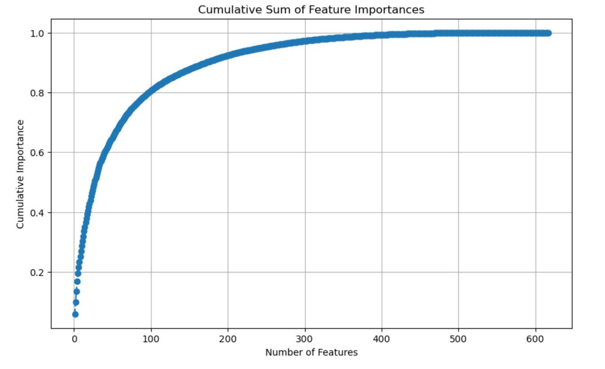
Model Development Process: Tuning The Random Forest Model
Dummy Classifier
Re-run and evaluate the model
CrossValidate & RandomSearchCV
Custom Threshold
Cumsum Feature Importances

Slide 13
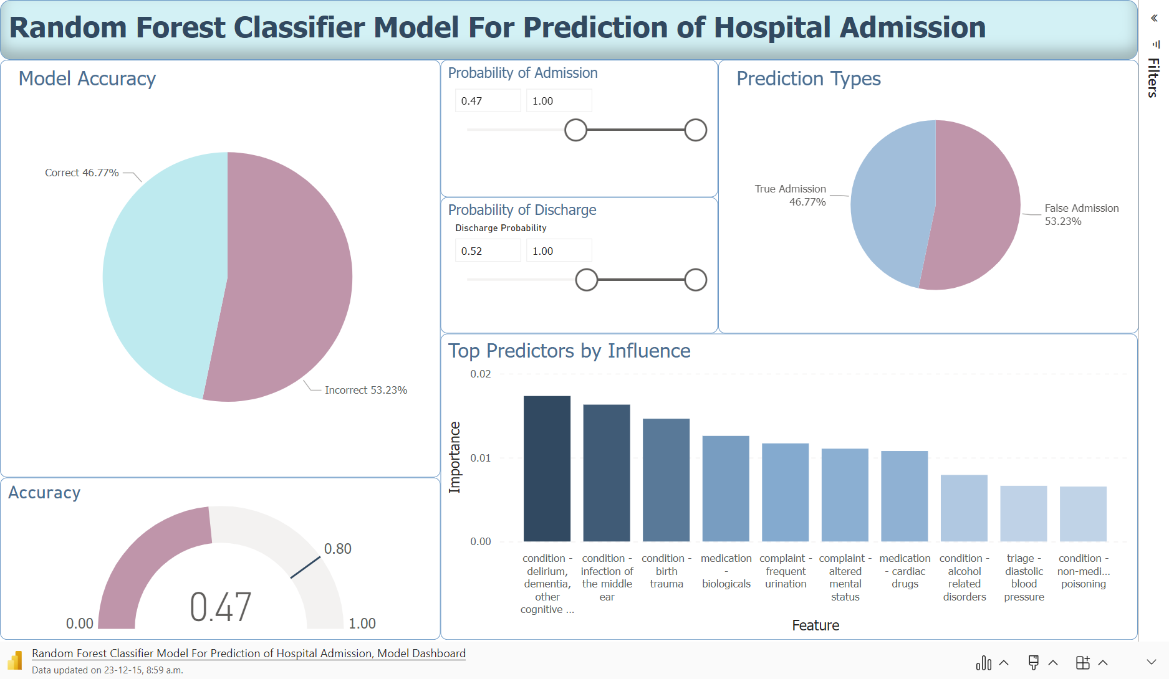

Slide 14


Insights & Recommendations
Model Insights
Patient Data Key Insights
False Discharge Rate:
< 5%
Busiest Times in the ER: 11am-2pm; March-June*
ESI Level 2 drops for ESL patients
Underutilization of hospital resources by ESL patients
False Admission Rate:
16%
Most common underlying condition: High Blood Pressure
Commonly occurs with other heart-related conditions
Accuracy:
80%
Most common complaints: abdominal pain & "other."
Commonly occurs with other stomach issues
Most influential variable: History of Cognitive Disorders
* Note that data is missing January – February 2014, and August – December 2017

Slide 15

References
Carrasquillo O, Orav EJ, Brennan TA, Burstin HR. "Impact of language barriers on patient satisfaction in an emergency department." J Gen Intern Med. 1999 Feb;14(2):82-7. Doi: 10.1046/j.1525-1497.1999.00293.x. PMID: 10051778
Hong WS, Haimovich AD, Taylor RA (2018) "Predicting hospital admission at emergency department triage using machine learning." PLoS ONE 13(7): e0201016 https://doi.org/10.1371/journal.pone.0201016.
Tam, H.L., Chung, S.F. & Lou, C.K. "A review of triage accuracy and future direction." BMC Emerg Med 18, 58 (2018). https://doi.org/10.1186/s12873-018-0215-0
North Carolina State University. (2021, April 20). "Role of physical, mental health in cognitive impairment." ScienceDaily. Retrieved December 12, 2023 from www.sciencedaily.com/releases/2021/04/210420121433.html
Hitzek J, Fischer-Rosinský A, Möckel M, Kuhlmann SL, Slagman "A. Influence of Weekday and Seasonal Trends on Urgency and In-hospital Mortality of Emergency Department Patients." Front Public Health. 2022 Apr 25;10:711235. doi: 10.3389/fpubh.2022.711235. PMID: 35530732; PMCID: PMC9068998.

